Slide 1
Lab meeting ishaque group Deconvolution of Cell Type Ancestry in Partially Methylated Domains (PMDs)
Olivia Gallupová Berlin, 2019/09/24

Slide 2
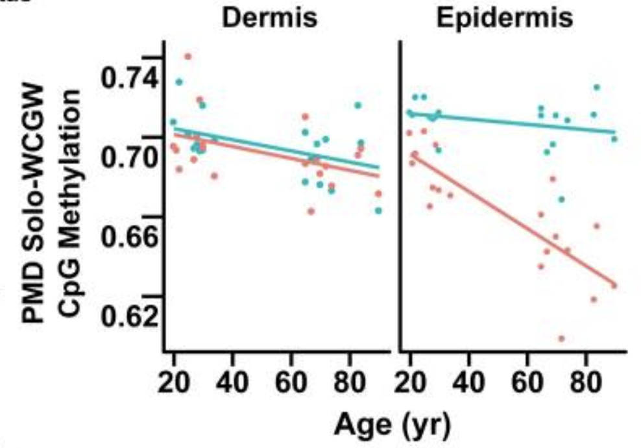
Partially Methylated Domains
Found in all chromosomes
Genes that are inactive
~25-75% methylation
Long, 100kbp regions
Mutation rate higher within PMDs
Fig. 6: Zhou et al. DNA methylation loss in late-replicating domains is linked to mitotic cell division
Notes:
What are they?
Graph from paper
VISUAL: that meth cliff thing nav always draws - talk about promoter strength and mutation
what are their characteristics, profile, what do they look like, past research, current research has revealed, difference to promoter methylation
Ave count of CpG's per PMD...
non-clonal variants in PMD regions

Slide 3
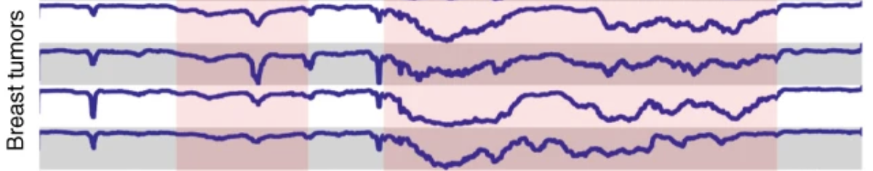
Partially Methylated Domains
Mechanism:
Heterochromatin loses methylation marks with each replication
Characteristic of PMDs:
Differentiation
Age (cell division count)
Stage of cell cycle
100kbp
1
Fig. 1: Brinkman et al. Partially methylated domains are hypervariable in breast cancer and fuel widespread CpG island hypermethylation
0
Notes:
Mutation rate higher
what are their characteristics, profile, what do they look like, past research, current research has revealed, difference to promoter methylation
non-clonal variants in PMD regions

Slide 4
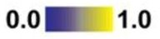
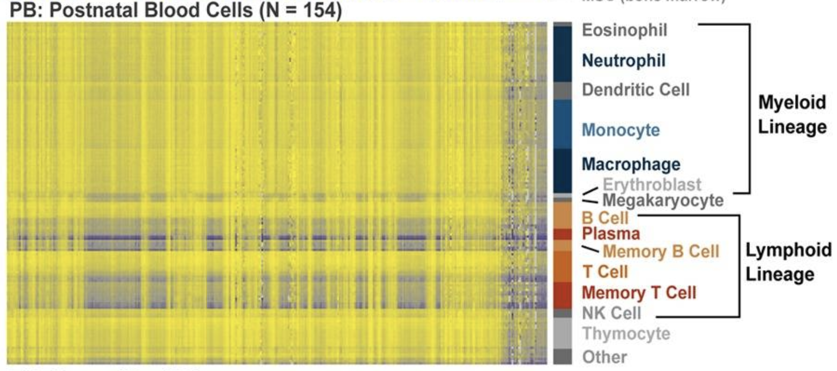
Research on PMDs
PMDs more apparent in cancer cells (and placenta)
Heterochromatic changes
Fig. 3: Brinkman et al. Partially methylated domains are hypervariable in breast cancer and fuel widespread CpG island hypermethylation
Fig. 3, Zhou et al. DNA methylation loss in late-replicating domains is linked to mitotic cell division
Notes:
Initially found in placenta outside of cancer
Groundbreaking studies 2018 that established how widespread they are
VISUAL: PMD tracks in normal cells and cancer on next slide

Slide 5
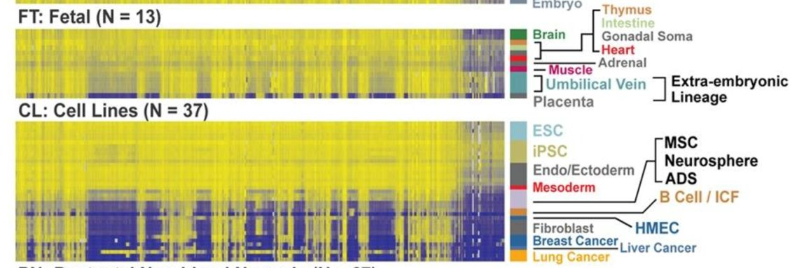
Research on PMDs: Cancer
Fig. 3, Zhou et al. DNA methylation loss in late-replicating domains is linked to mitotic cell division

Slide 6
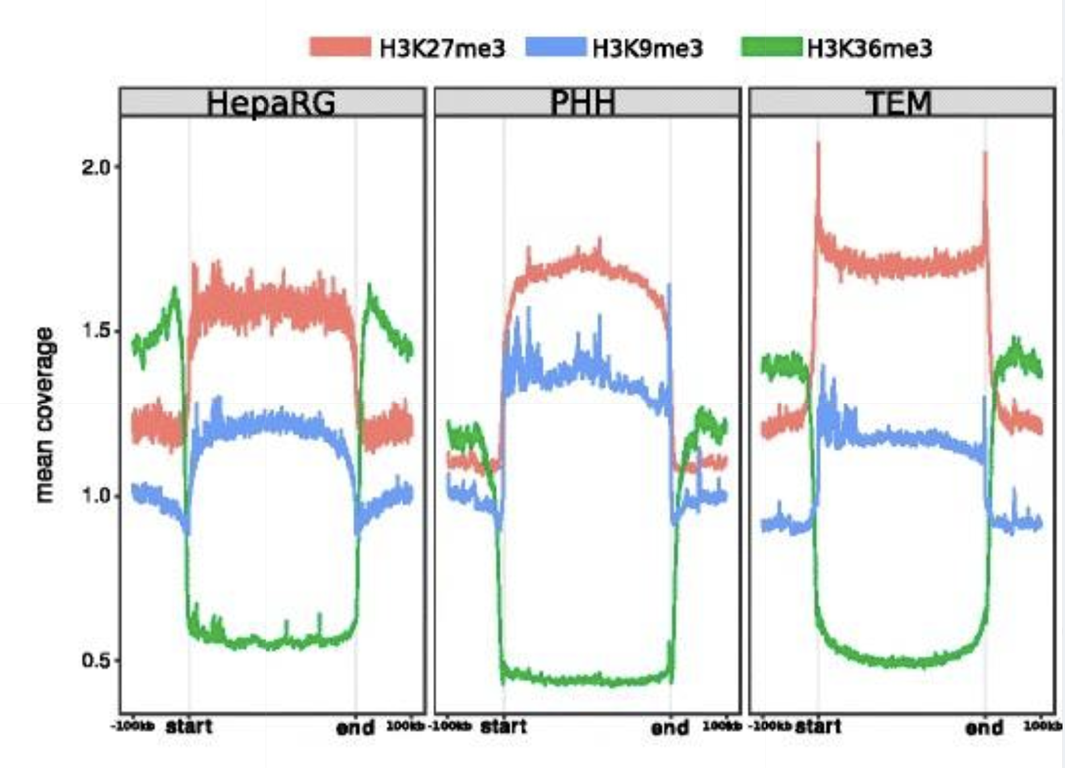
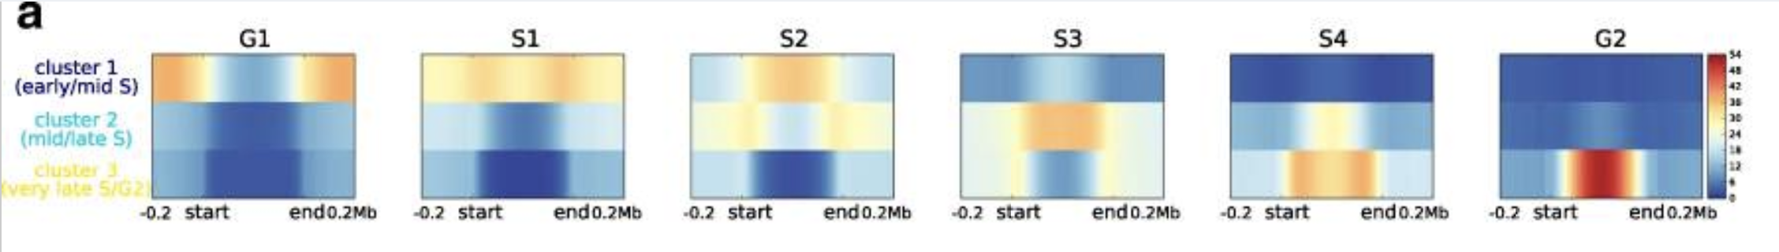
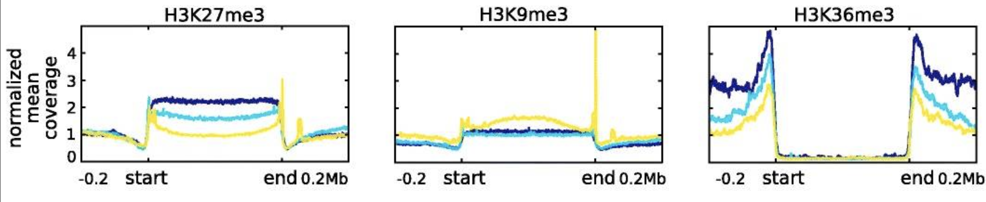
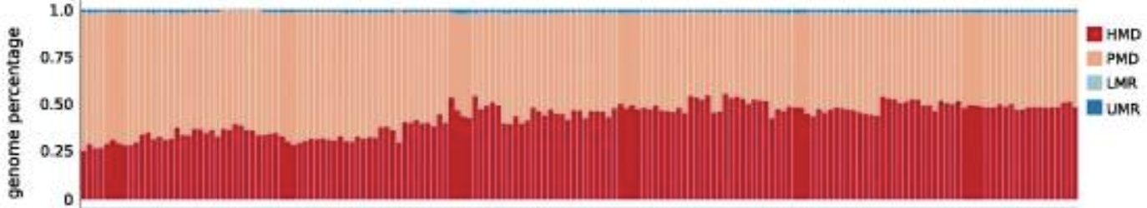
Research on PMDs
Fig. 2&4: Salhab et al. A comprehensive analysis of 195 DNA methylomes reveals shared and cell-specific features of partially methylated domains
Notes:
PMDs are widespread, found in 20-40% of genome
Replication timing predicted by heterochromatin signature in PMDs
Heterochromatin signature is interesting within PMDs but harder to study

Slide 7
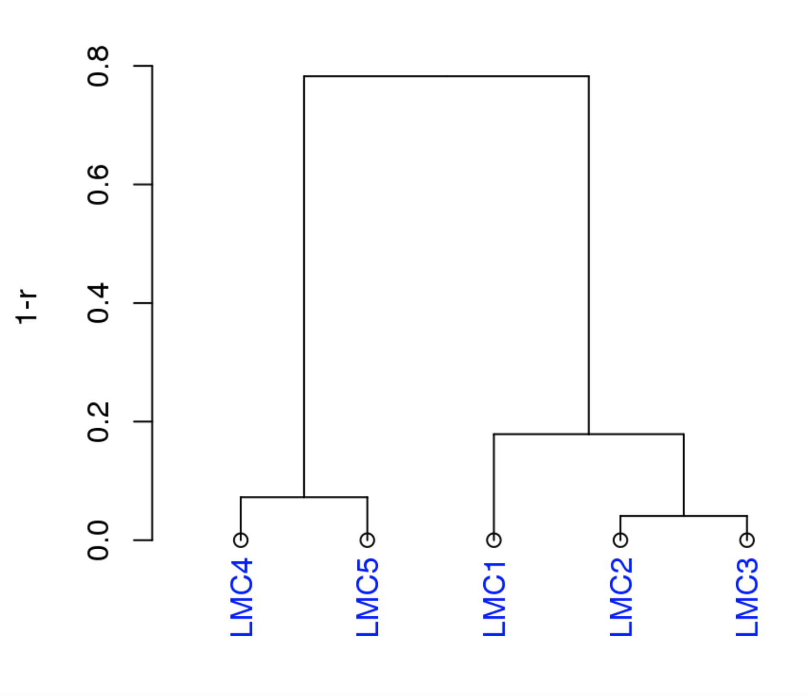
Cell Type Decomposition
Significance
Tissue samples often mixture of cells
Tumors vary in cell make-up
Clustering could label cell types within tissue
MeDeCom
Unsupervised
NMF
MeDeCom Vignette: Latent Methylation Component grouping
Notes:
Medecom: one of the developers is DKFZ
Attempts to deconvolve cell composition using methylation data (WGBS)
Latent methylation components are extracted via NMF – represent the amount of diff cell populations
Has docs and a visualization tool
MseekR
Where are they used

Slide 8
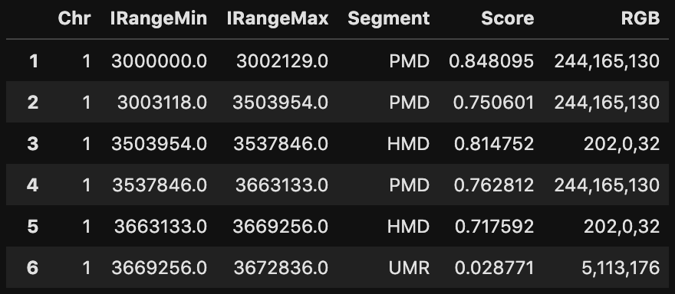
PMD Classification
MethylSeekR
Segmentation into PMD, HMD, LMR, UMR
10x coverage min
WGBS data after segmentation via MethylSeekR
Notes:
MethylSeekR paper has over 600 citations

Slide 9
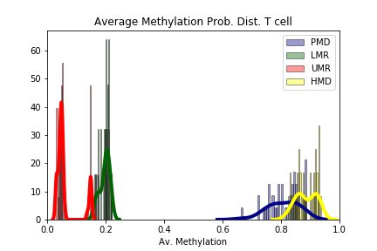
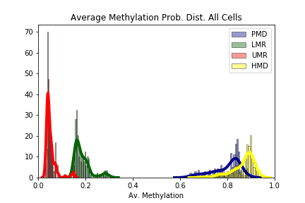
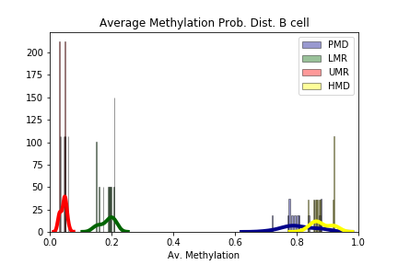
PMD Classification
Notes:
Unmethylated has highest, near 0 ave. Meth
SCALES AREN'T The same
Small part of PMDs get classed as UMRs or HMDs – MethylSeekR problem
PMDs and HMDs overlap a lot too; in T cell distribution they are being miscalled
This is why coverage needs to be high to minimize these mistakes

Slide 10
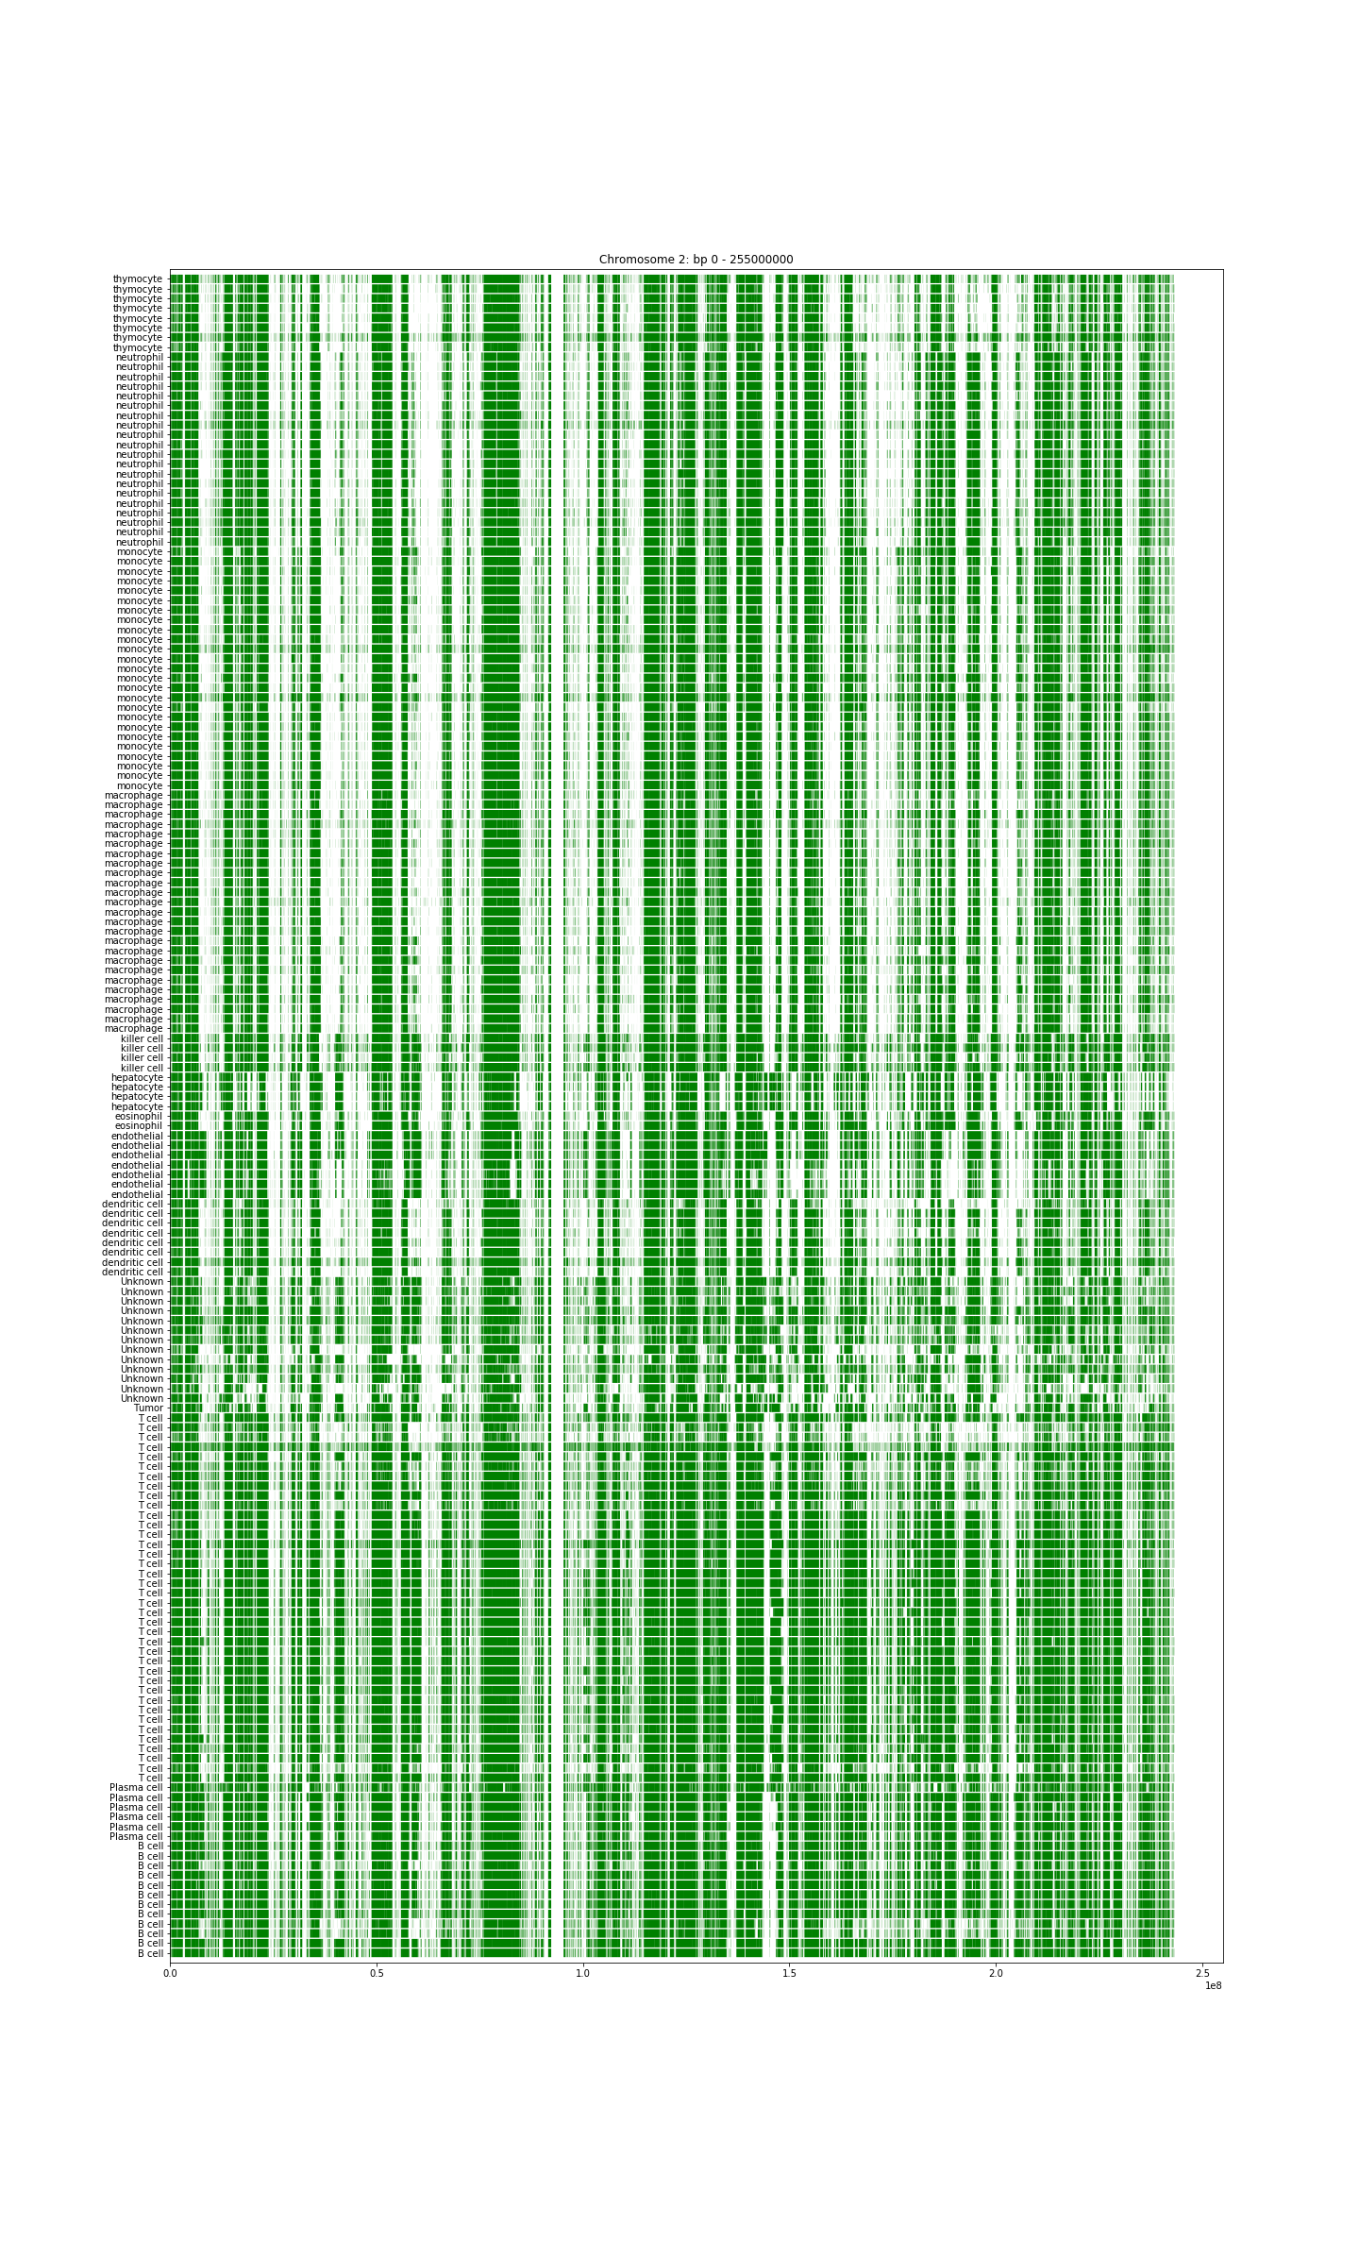
PMD Signature

Slide 12
Future work
Preparation
Marking aberrant regions of samples
Characterizing PMDs signatures
Clustering of PMDs & validating via known cell type (MeDeCom)
Target regions of high PMD variability between cell types
Statistical significance of classification

Slide 13
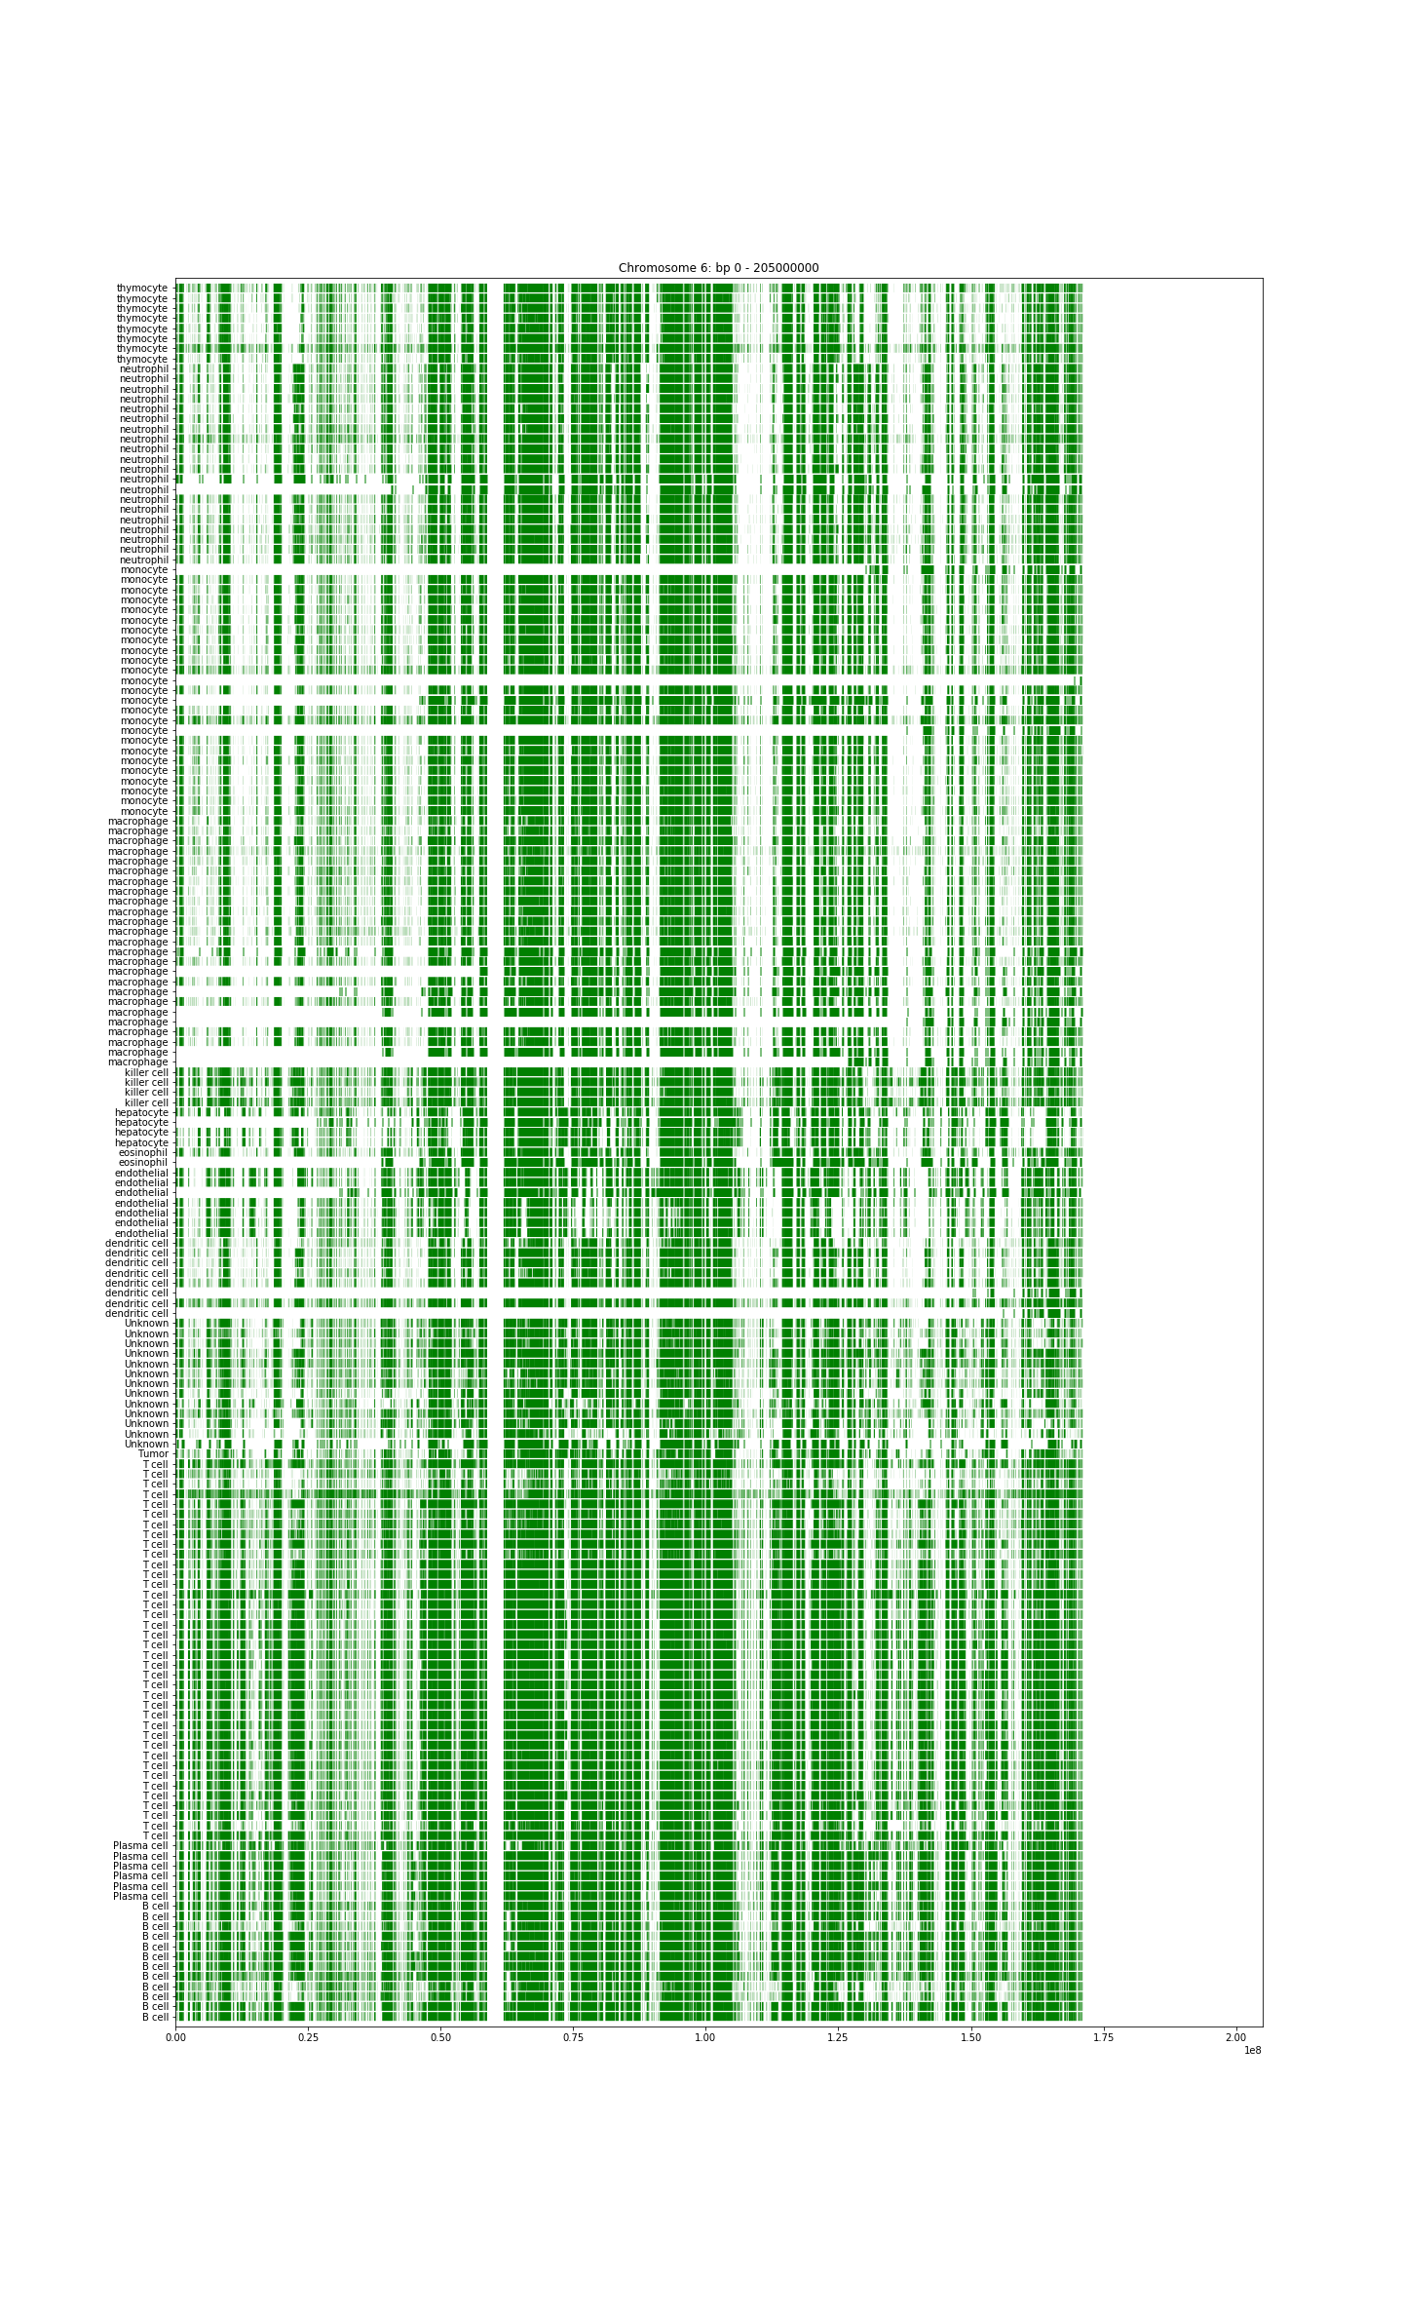
Sequencing error in samples

Slide 14
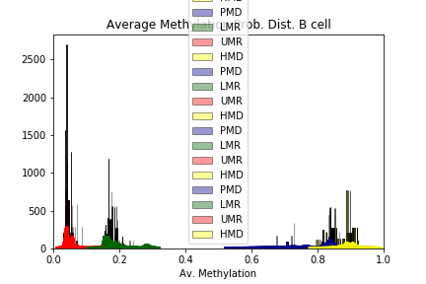
Challenges
Computational capacity & storage
Dependency issues
Cleaning PMD data
Data annotation
R packages: GRanges, MethylSeekR
Notes:
Don't talk about external challenges like lack of access to data
1. MethylSeekR space BUT NOT JUST THAT; making things efficient enough so that they could be processed and run in the first place by the program itself was sometimes challenging
2. solve with nice virt env
3. dataframes not running cuz they were too large (@Julius), hacky for loops and ifs, solution finally with numpy
4. Matching original cell data with transformed one.........
R packages: docs ok for the things I was using, ofc there were many small things that are specific to the program that trip you up before you can debug them, pandas is like a more powerful granges tho

Slide 15
Literature
Early Developmental and Evolutionary Origins of Gene Body DNA Methylation Patterns in Mammalian Placentas: https://www.ncbi.nlm.nih.gov/pubmed/26241857
DNA methylation loss in late-replicating domains is linked to mitotic cell division: https://www.ncbi.nlm.nih.gov/pmc/articles/PMC5893360/
Partially methylated domains are hallmarks of a cell specific epigenome topology: https://www.biorxiv.org/content/10.1101/249334v1
A comprehensive analysis of 195 DNA methylomes reveals shared and cell-specific features of partially methylated domains: https://www.ncbi.nlm.nih.gov/pmc/articles/PMC6161375/
Mechanisms of establishment and functional significance of DNA demethylation during erythroid differentiation: http://www.bloodadvances.org/content/2/15/1833?sso-checked=true
Macrophages associated with tumors as potential targets and therapeutic intermediates: https://www.ncbi.nlm.nih.gov/pmc/articles/PMC4149280/
IHEC Portal: http://ihec-epigenomes.org/

Slide 16
Vielen dank!!

